Slide 1
Recovery and Employment:
"From Cost to Contribution"

Slide 2
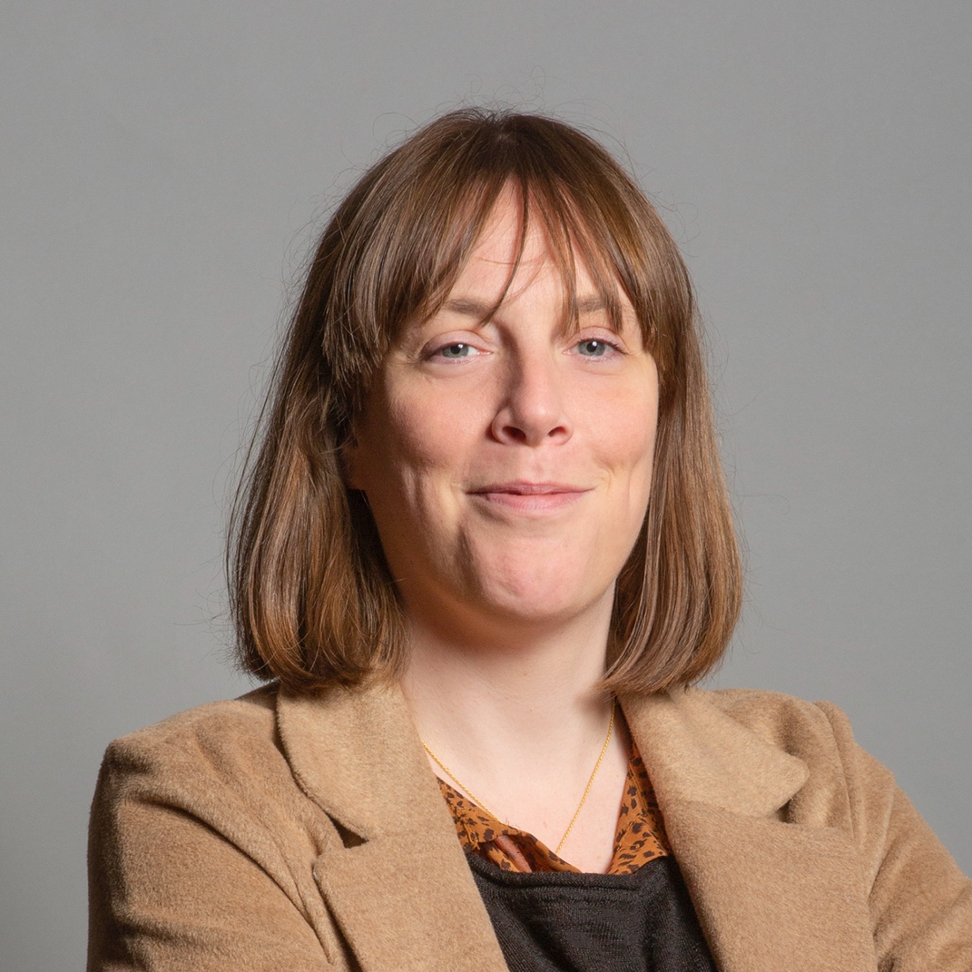
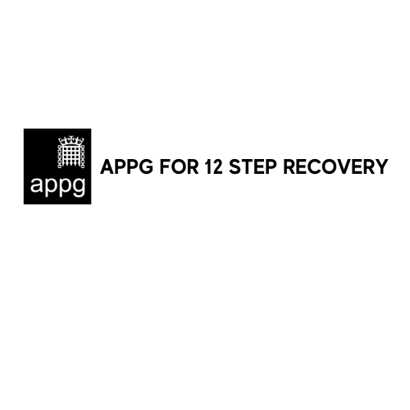
Cost to Contribution
JESS PHILLIPS MP

Slide 3
Wellbeing > Mental Health > Addiction > Recovery > Wellbeing
Alcohol & drugs negatively affect mental health and wellbeing in the short and long term
Uni Swansea study: >70% of young people with substance use disorder also had a record relating to mental health

Slide 4
Wellbeing > Mental Health > Addiction > Recovery > Wellbeing
Addiction contributes to the development of new, or worsens existing, mental health issues
Alcohol dependence leads to:
2 x Depression
Anxiety and depression leads to:
4 x Alcohol dependence

Slide 5
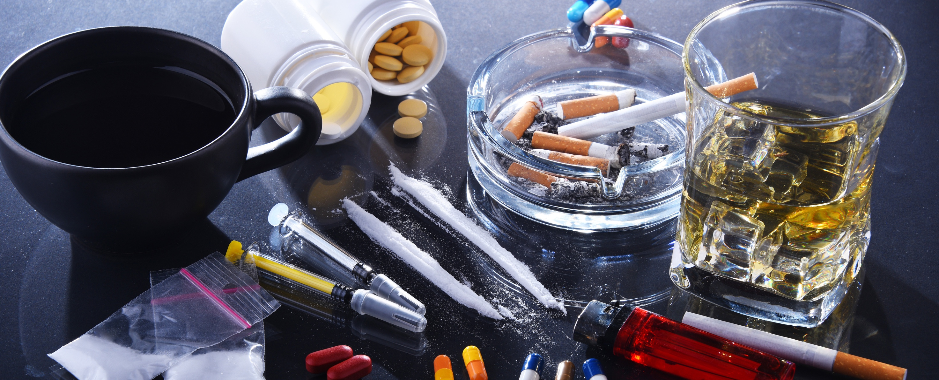
Wellbeing > Mental Health > Addiction > Recovery > Wellbeing
Opioids
Cannabis
Cocaine
Alcohol
Schizophrenia
/Psychosis
Bipolar
/Psychosis
Depression
Depression

Slide 6
Wellbeing > Mental Health > Addiction > Recovery > Wellbeing
Alcohol: £7bn a year in lost productivity
Alcohol: 167,000 working YEARS (over 43m working days) lost every year
Illegal Drugs: £19bn cost to UK each year

Slide 7
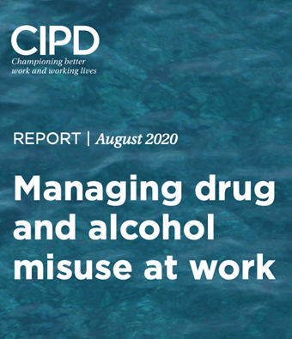
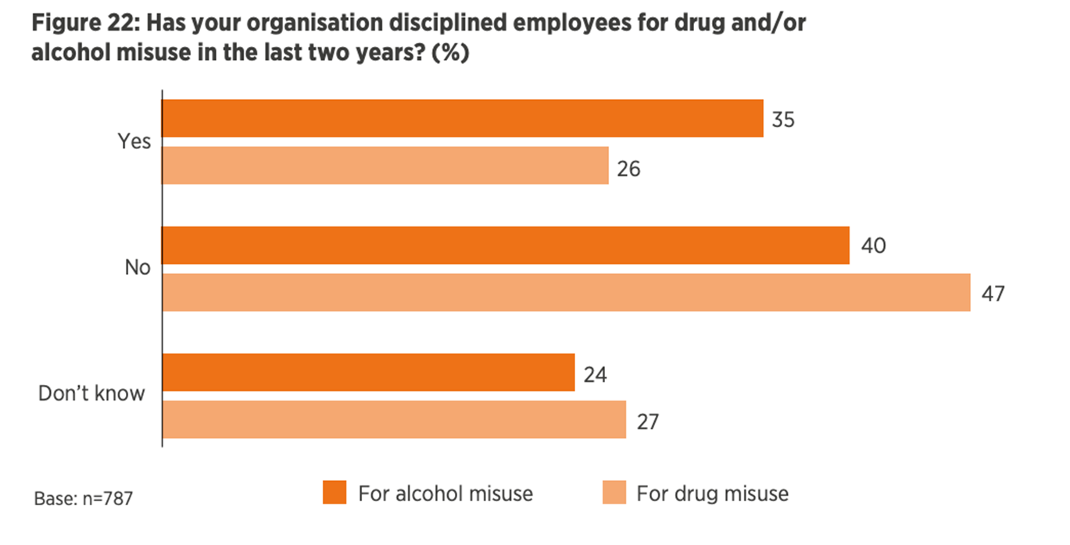
Cost to Contribution: the cost to employers

Slide 8
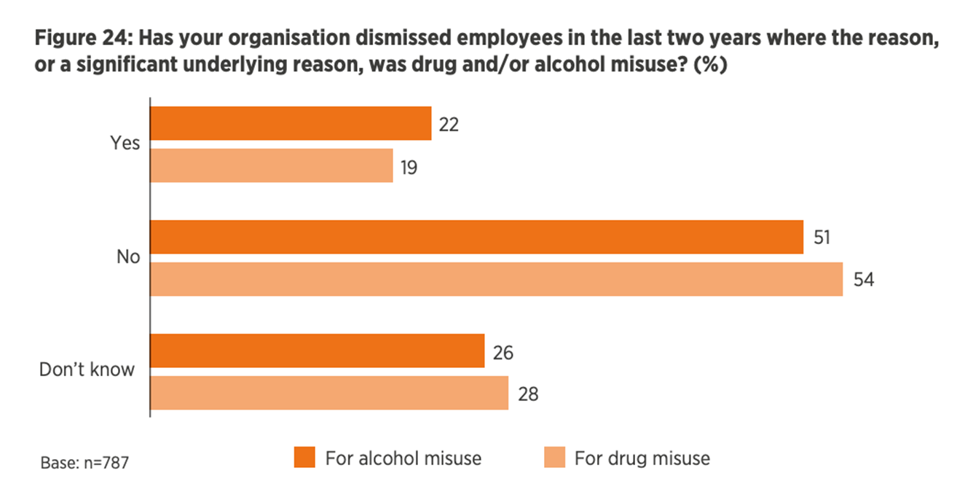
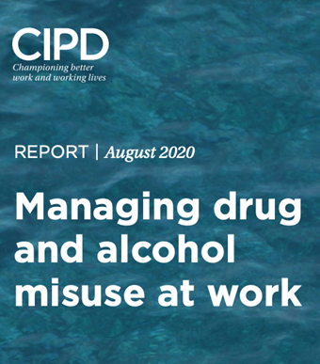
Cost to Contribution: the cost to employers

Slide 9
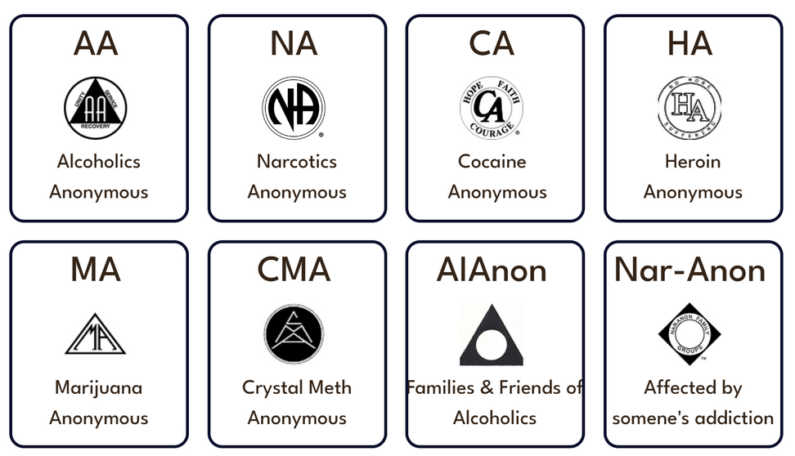
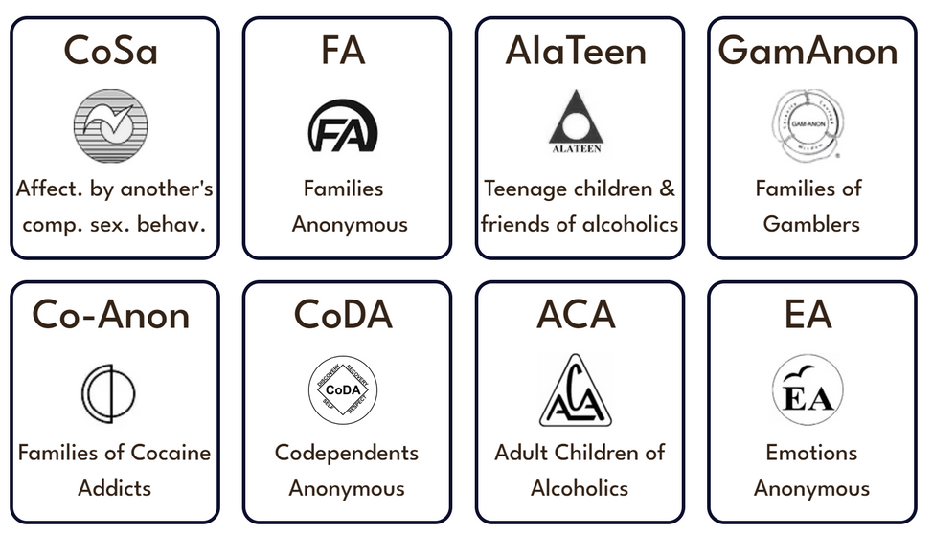
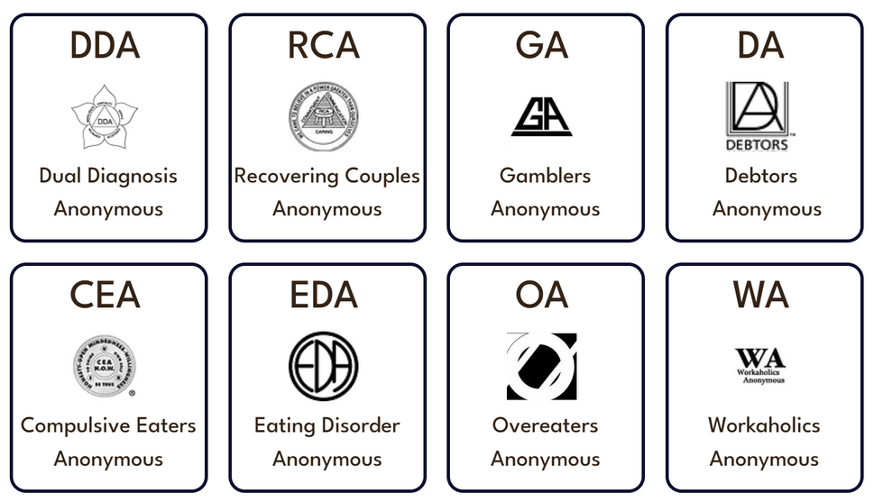
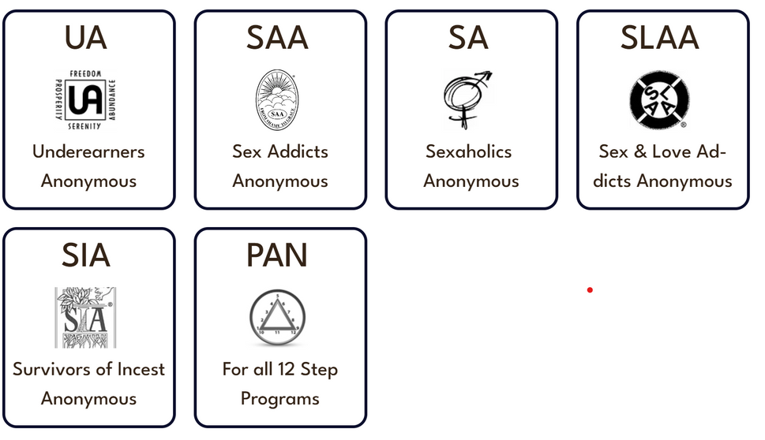
Wellbeing > Mental Health > Addiction > Recovery > Wellbeing
Source: www.12stepsappg.com/12-fellowships

Slide 10
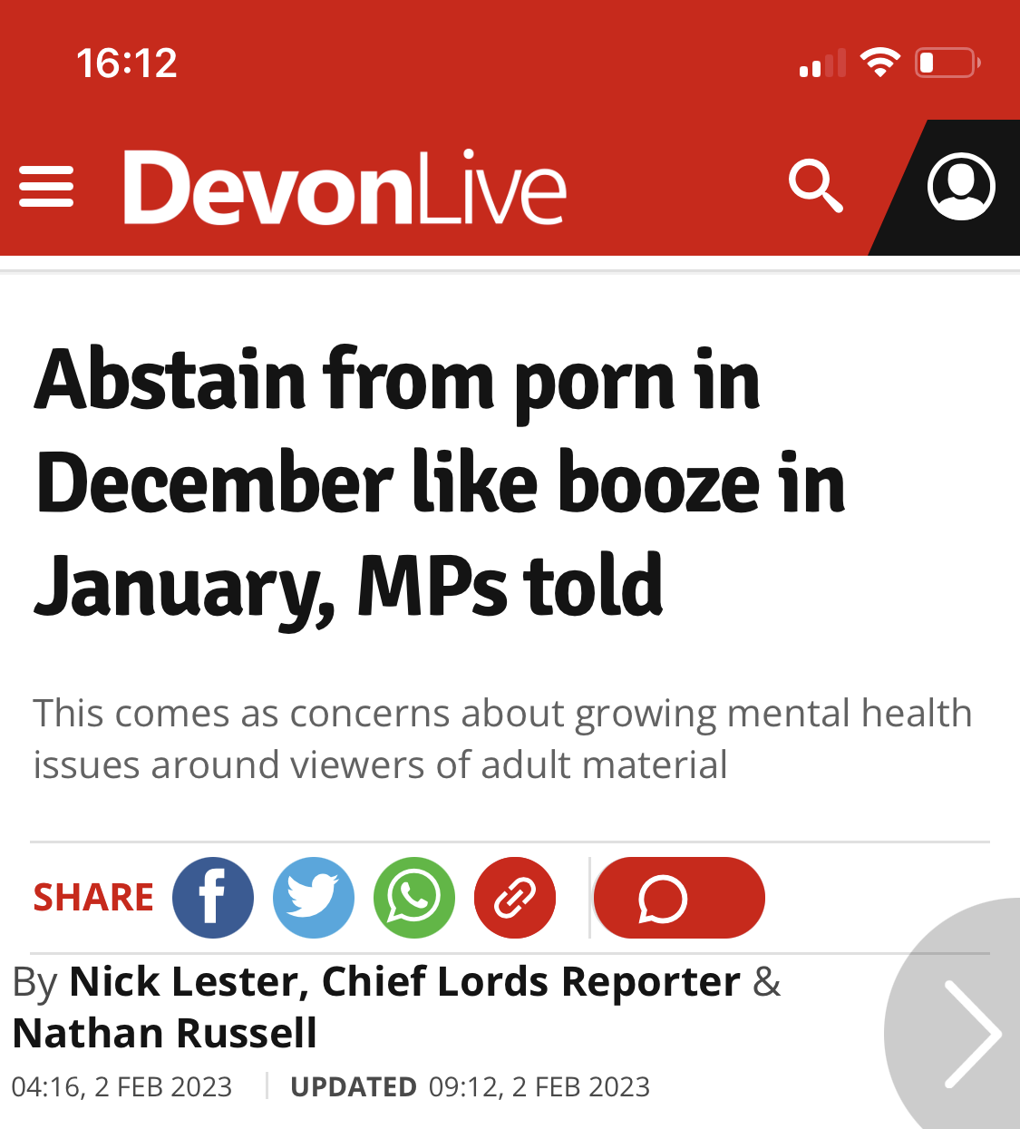
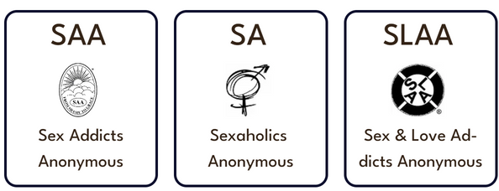
Beyond Alcohol & Drugs: SEX/PORN ADDICTION
Loss of employment … in this house
Lord Brooke and other peers discussing porn and sex addiction as part of the On-Line safety bill

Slide 11
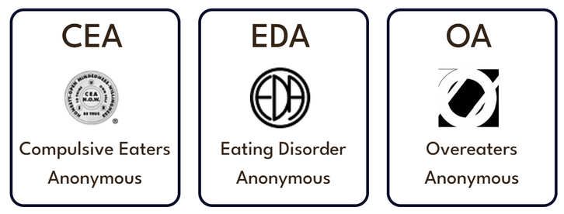
Beyond Alcohol & Drugs: FOOD ADDICTION
Obesity is implicated in multiple health conditions e.g.
Diabetes
Heart disease
Stroke
Many cancers
Clinical depression & anxiety

Slide 12
Beyond Alcohol & Drugs: GAMBLING ADDICTION
300,000 “problem gamblers”
a further 1.8 million “at risk”
Work impacts:
Reduced productivity
Increased absence
Low morale

Slide 13
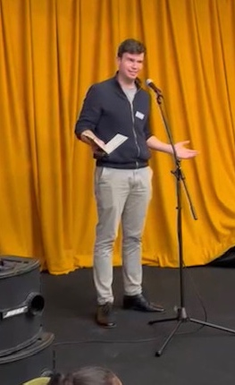
To contribution:
A solution for employers
“12 Step Recovery is proven to work. It’s free and is widely available nationwide.
Over 30 Anonymous fellowships hold over 7,000 meetings per week in the UK, allowing tens of thousands of people to recover from addictions and dependencies that blight their lives, and the lives of their families”
Dan Carden MP, Liverpool 2022

Slide 14
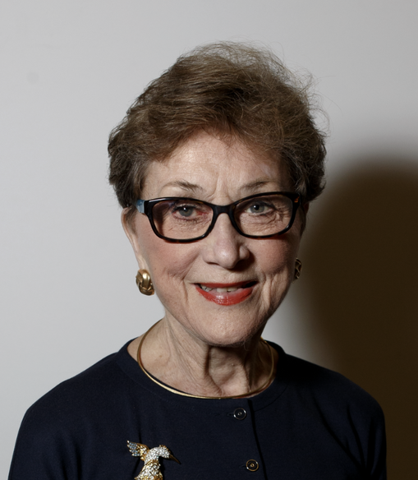
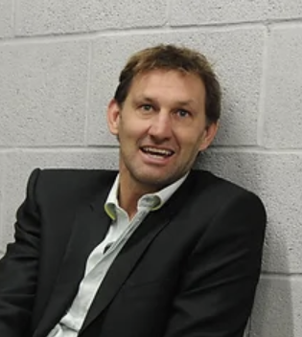
Cost to Contribution: SPEAKERS
DAME CAROL BLACK
TONY ADAMS MBE

Slide 15
Dame Carol Black

Slide 16
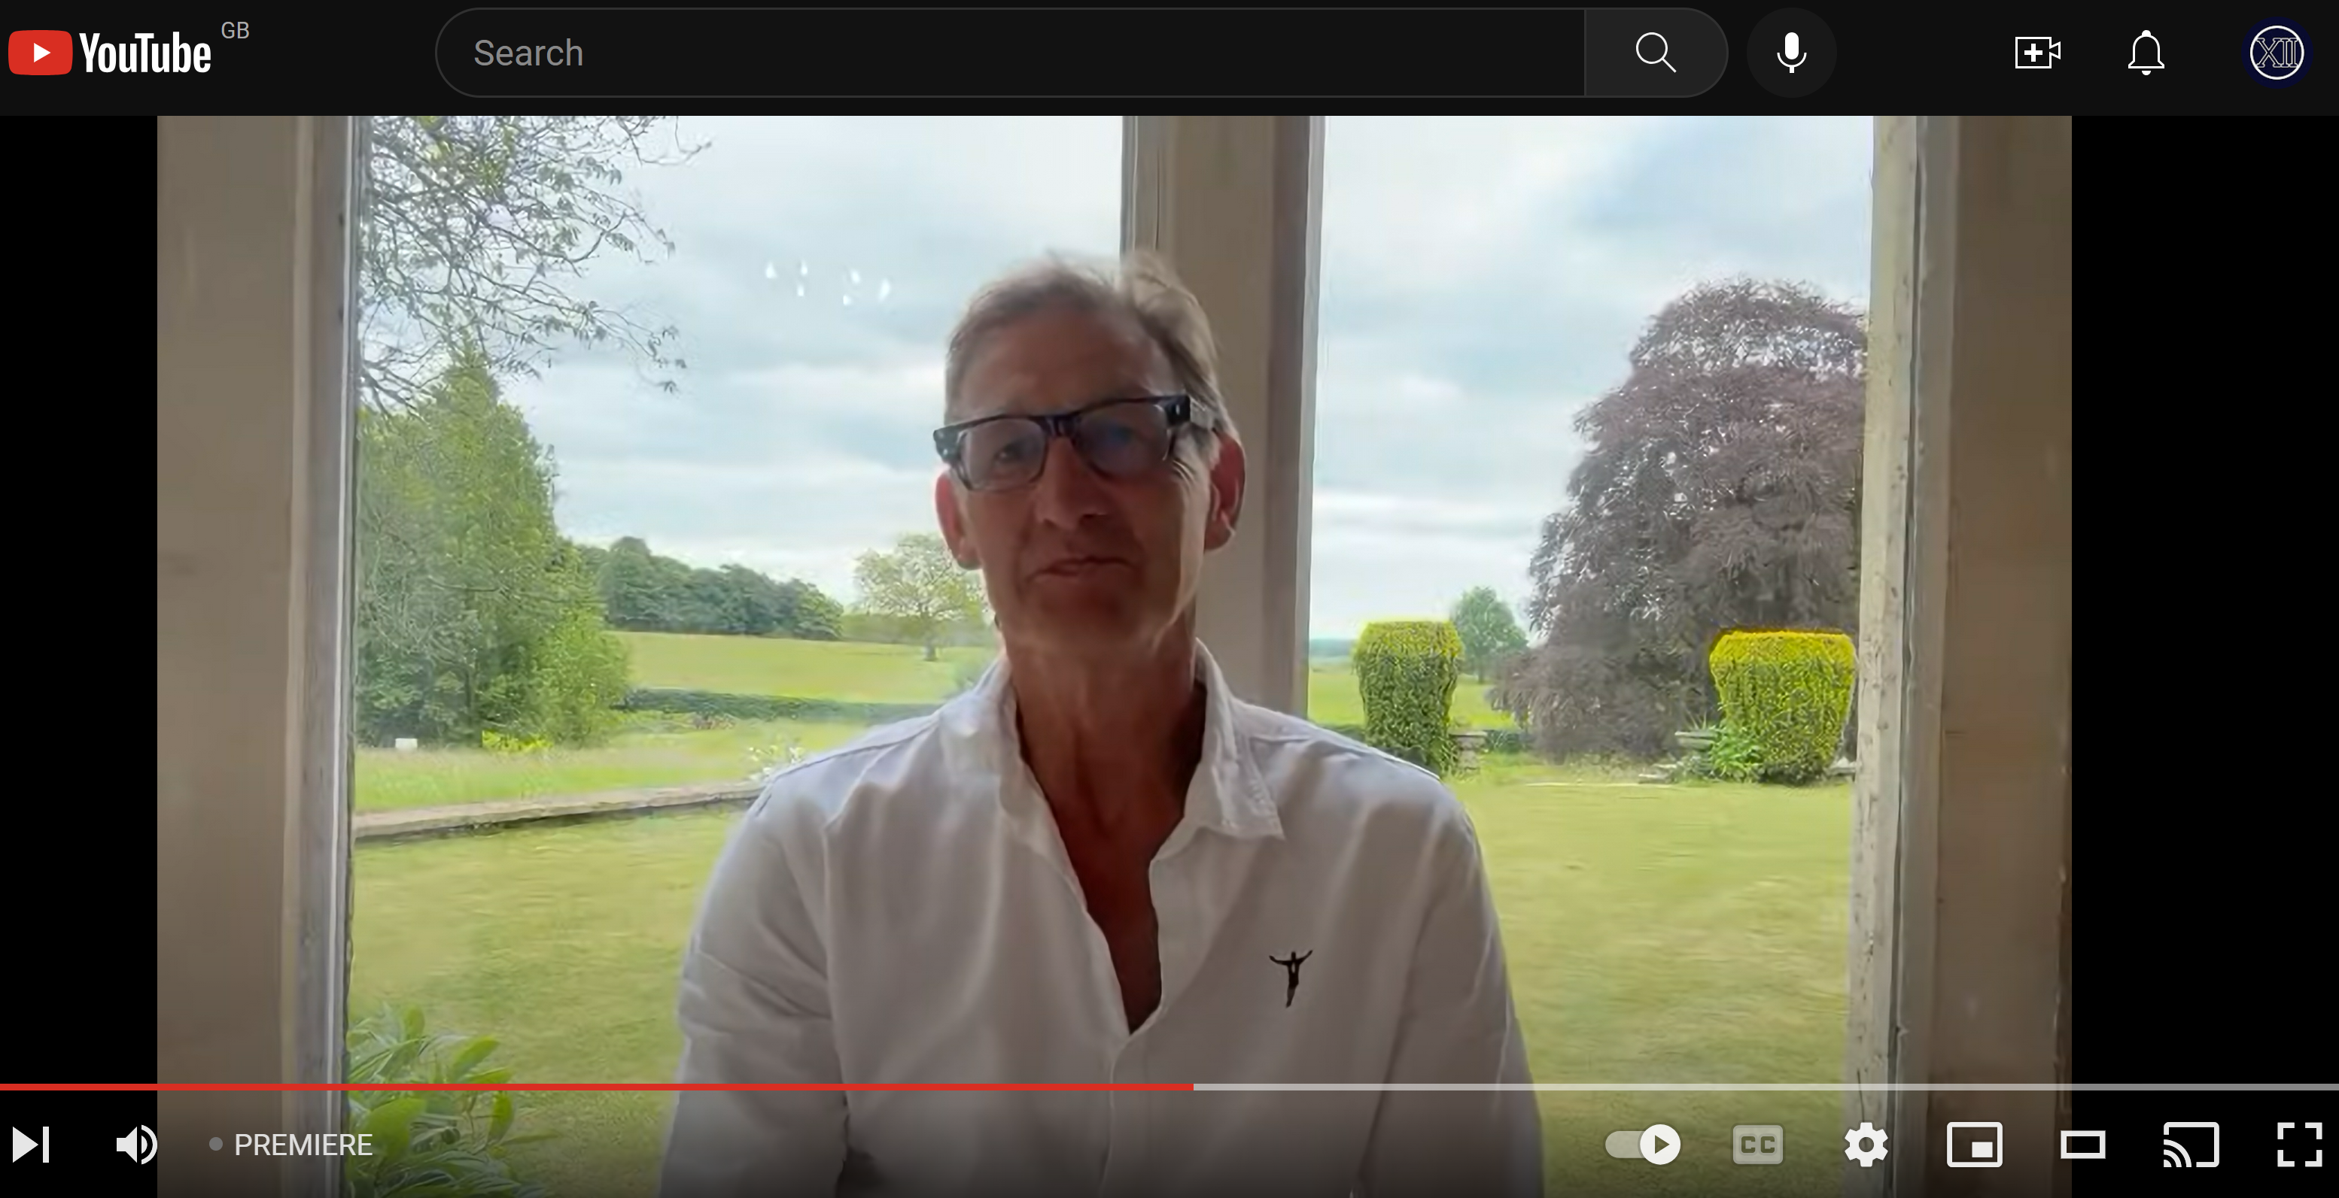
TONY ADAMS MBE

Slide 17
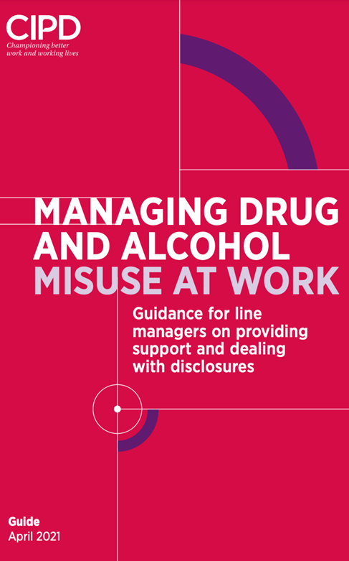
To contribution:
A SOLUTION FOR EMPLOYERS
Source: www.cipd.org/en/knowledge/guides/drug-alcohol-misuse-work-guide/

Slide 18
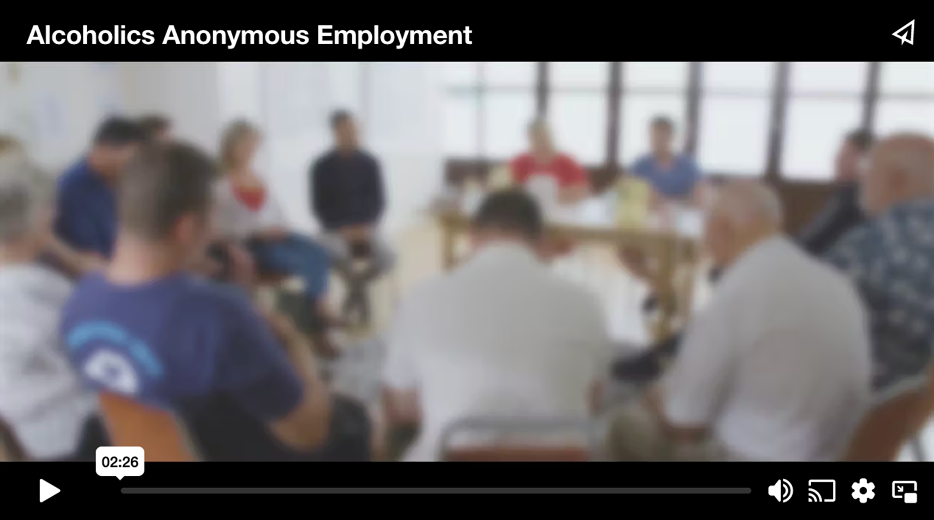
AA – For Employers
Source: www.alcoholics-anonymous.org.uk/professionals/Videos-for-Professionals

Slide 19
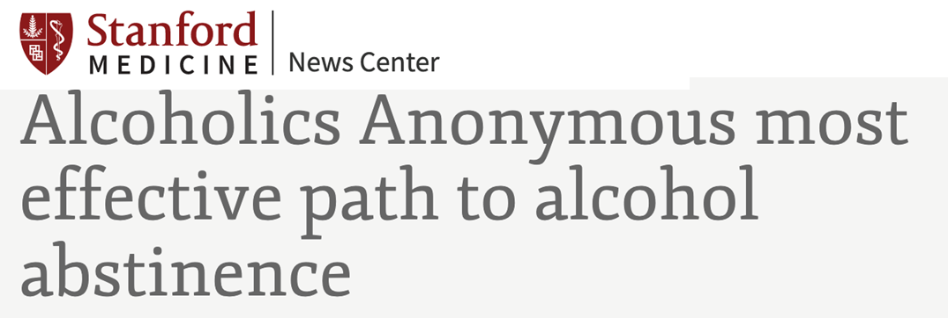
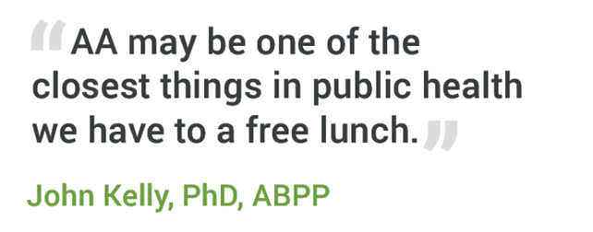
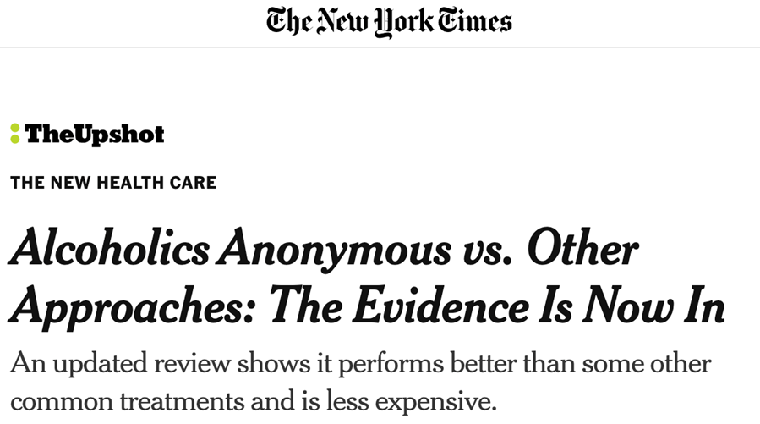
Your employees may say "but it doesn’t work..."

Slide 20
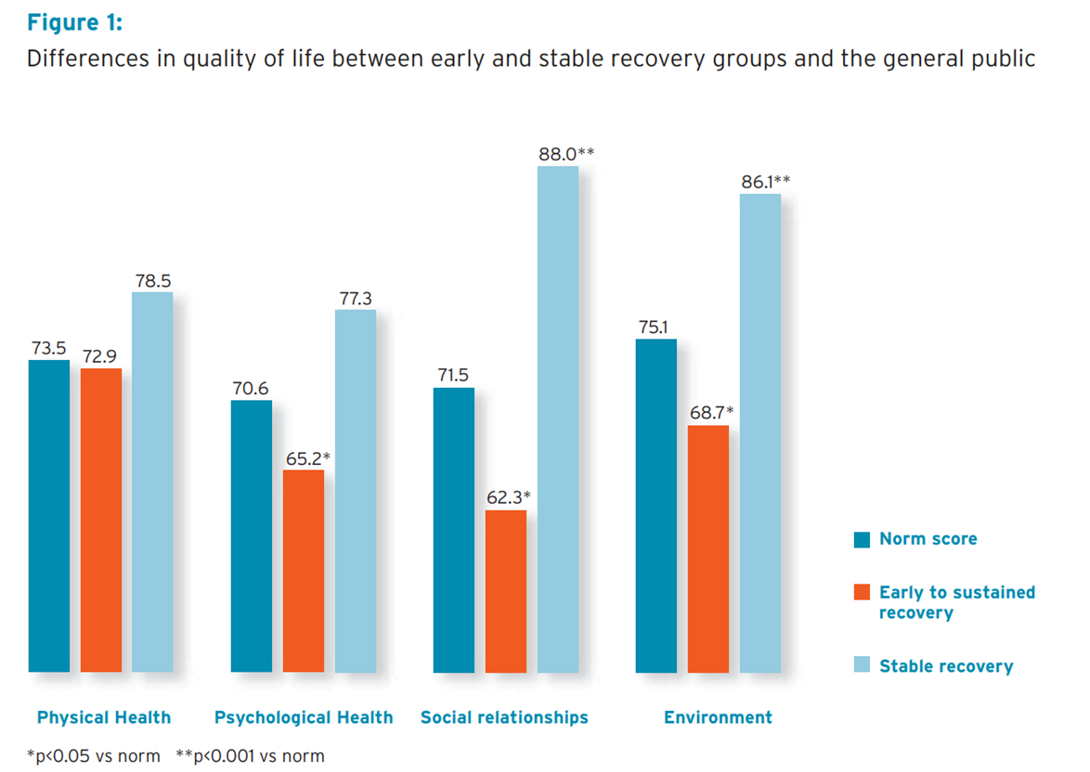
For employers – Recovery leads to “better than well”
Source: https://scottishrecoveryconsortium.org/wp-content/uploads/2020/04/src-digesting-the-evidence-research-1.pdf

Slide 21
For employers – Recovery leads to “better than well”
Source: https://scottishrecoveryconsortium.org/wp-content/uploads/2020/04/src-digesting-the-evidence-research-1.pdf

Slide 22
For employers – Recovery leads to “better than well”
Source: https://scottishrecoveryconsortium.org/wp-content/uploads/2020/04/src-digesting-the-evidence-research-1.pdf

Slide 23
BETTER THAN WELL...
2020 US based analysis:
Employer initiated treatment is MORE successful than treatment initiated by friends or family
Employees who recover from Substance Use Disorder save a company over $8.5k on average
Have 3.5 LESS sick days than an average employee
Source: NORC Uni of Chicago

Slide 24
BETTER THAN WELL...
People who participate in 12 Step Programmes
are more likely to be employed
have higher rates of job satisfaction
earn higher wages
have lower rates of absenteeism, tardiness, and accidents
National Institute on Drug Abuse (US)
Substance Abuse and Mental Health Services Administration (US)
compared to people who do not participate in 12 Step Programmes.

Slide 25
NEXT STEPS FOR US
Increase / widen UK research on contribution of recovery
Call for evidence on cost of non drug/alcohol addiction
Create ‘NICE Guideline’ equivalents for employers

Slide 26
NEXT STEPS FOR YOU
Host a 12 step public information event at your place of work

Slide 27
Contact any of the fellowships & ask for a Public Information (PI) event at your place of employment
Source: www.12stepsappg.com/12-fellowships

Slide 28
Q & A

Slide 29
IF YOU HAVE ANY FURTHER QUESTIONS PLEASE GET IN TOUCH
APPG for 12 Step Recovery
Visible Recovery
zoe@visiblerecovery.uk
www.visiblerecovery.uk
www.12stepsappg.com
Visible Recovery is a registered charity and provides secretariat services to the APPG for 12 Step Recovery

